Slide 1


Organ Donation Online System
Section :A2B
Group:9
Razan Arif Alamri,
Raghad Nahari,
Shatha Binmahfouz,
Ebtihaj Alnaqeb,

Slide 2


Purpose:
Organ donation is the process when a person allows an organ of their own to be removed and transplanted to another person, legally, either by consent, while the donor is alive or dead with the assent of the next of kin.

Slide 3



Project Charter:
Project Title: Organ Donation Online System
Project Start Date: 1-9-2022
Project Finish Date: 22-1-2023
Project Manager:Amal Naser Alharbi, anaser-alharbi@gmail.com
Project Objectives: an online system that facilitates the donor, recipient, and the Saudi Center for Organ Transplantation to achieve, spreading the culture of organ transplantation in the community
Main Project Success Criteria:
Scope: The project includes all requirements within the specific scope
Time: Complete the project on or before the January 22,2023 deadline
Cost: Complete the project with a budget of 250,000 SAR or less

Slide 4

Approach
For donors: The donor should register in the application, then he can click to make donation. After that, he should file out his health records.
For patients: they can apply their needs for organs, and the system will notify them when having donors to complete the surgery procedures.
For administrations: They can review donation applications and approve them or reject them after viewing the health profile -which is provided by the ministry of health
After approving the donation application, the system must schedule a date for the operation coordinating with the hospitals.

Slide 5

Scope Statment:
The requirement collected in this project will work together, for achieving the project objectives
By storing information and contacts of :
Donors
Patients in need of organ transplantation.
Hospitals where the donor donates, or the patient goes to get the donation.

Slide 6
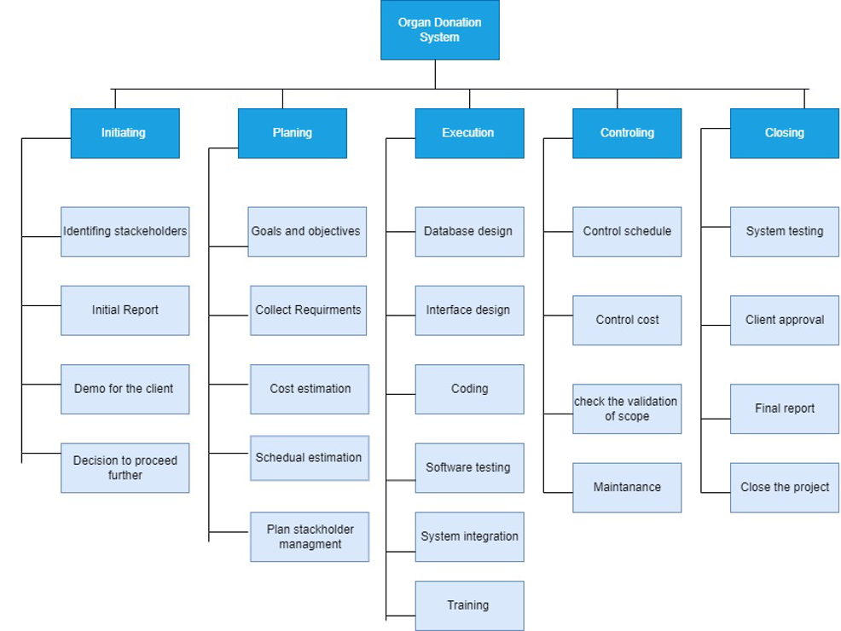

WBS:

Slide 7

Roles and Responsibilities (Stakeholder Register):
Amal Naser Alharbi
Huda Ali Alahmadi
Nadeen Mohammed Alharbi
Hind Kalid Nahari
Project Manager
Sponsor
Programmer
Analyst
Eman Abdullah Alnahdi
Lama Saleh Alzahrani
Sama Majed Almazmomi
Nada Salem Binmahfouz
Sara Sameer Alnajar
Quality Control
Database Developer
UI UX specialist
Co-manager
Finincal analyst

Slide 8
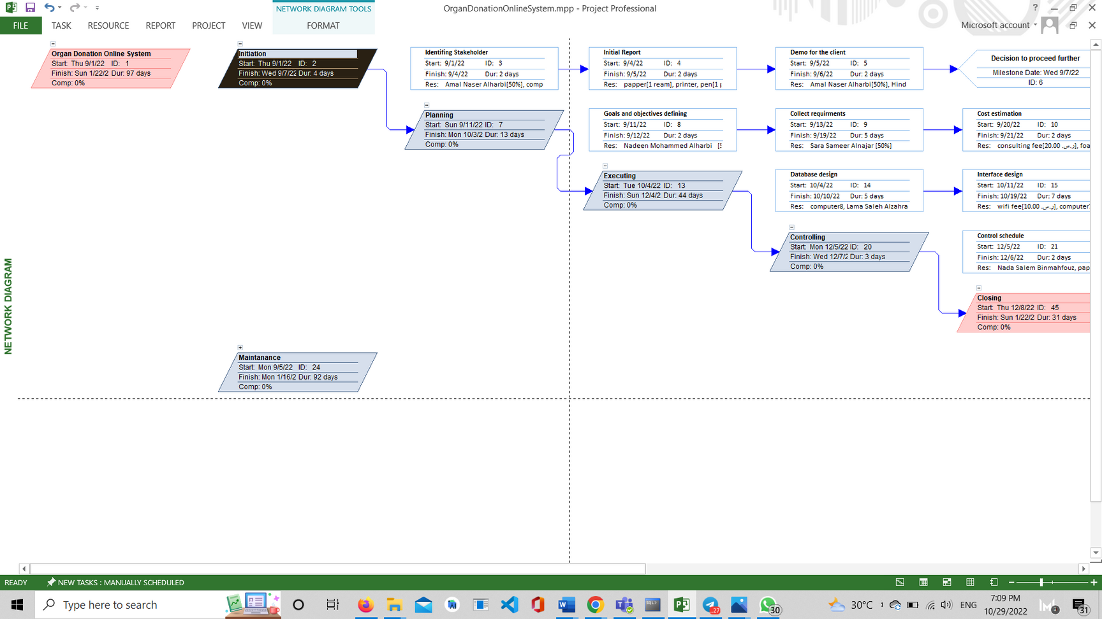
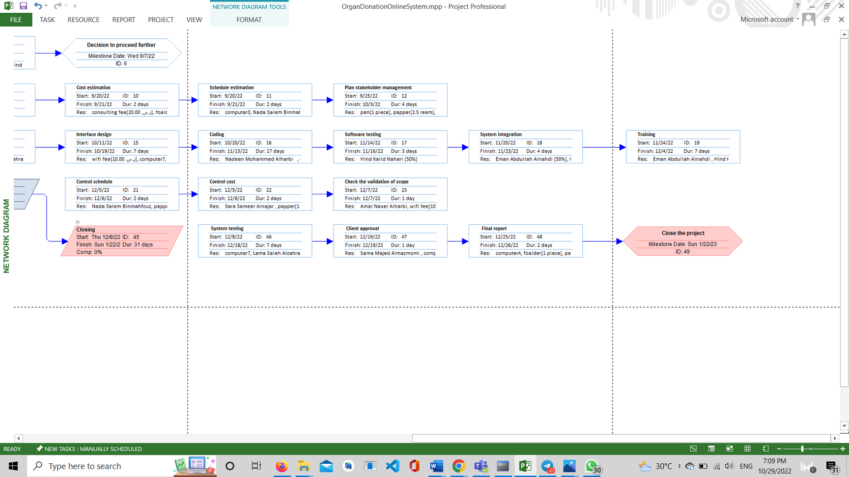
Precedence Diagram Method (PDM):
from left
from right

Slide 9
Staffing Procedure and Plan (HR Management):
Design and publish a job advertisement that includes all the requirements for a job offer.
Start receiving and evaluating all CVs based on the job standards.
Conducting interviews with all job candidates and determining if the applicant needs training.
Send a job offer to the accepted applicants that includes salary, start date of work and all benefits.
Signing the job contract and introducing the employees to the work environment.

Slide 10
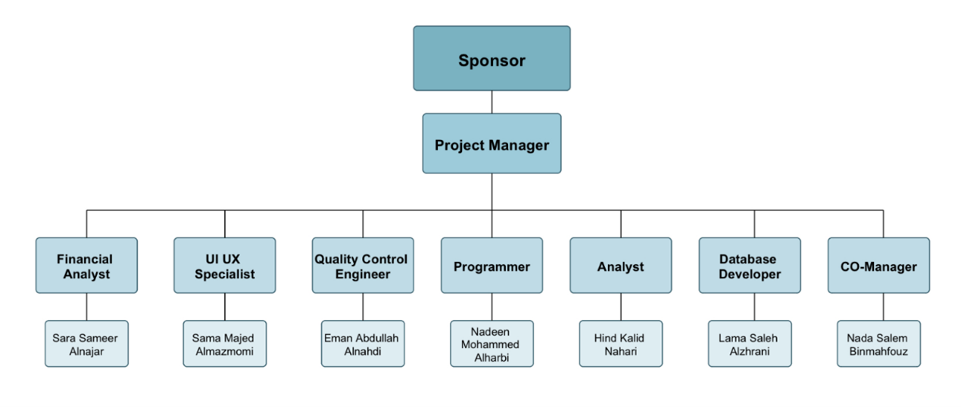
Organizational Chart (HR Management):

Slide 11
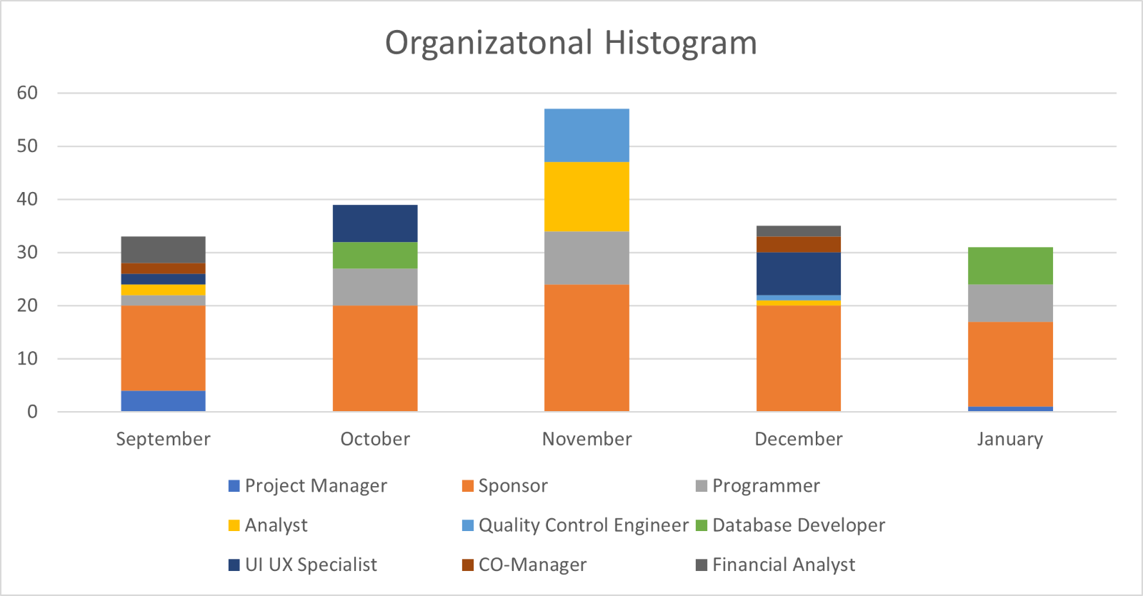
Organizational Histogram (HR Management) :

Slide 12
Detailed Project Schedule
Practical part

Slide 13
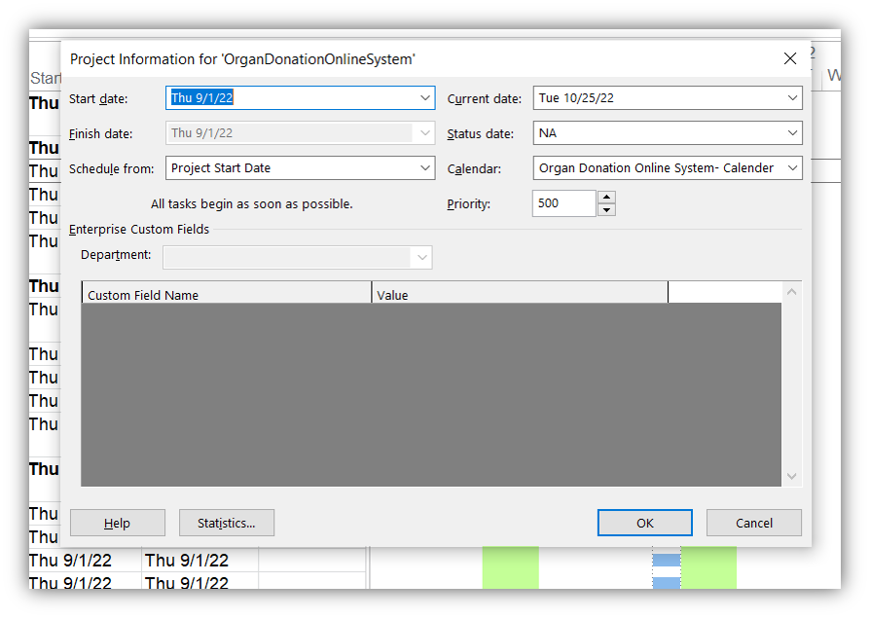
General project information

Slide 14
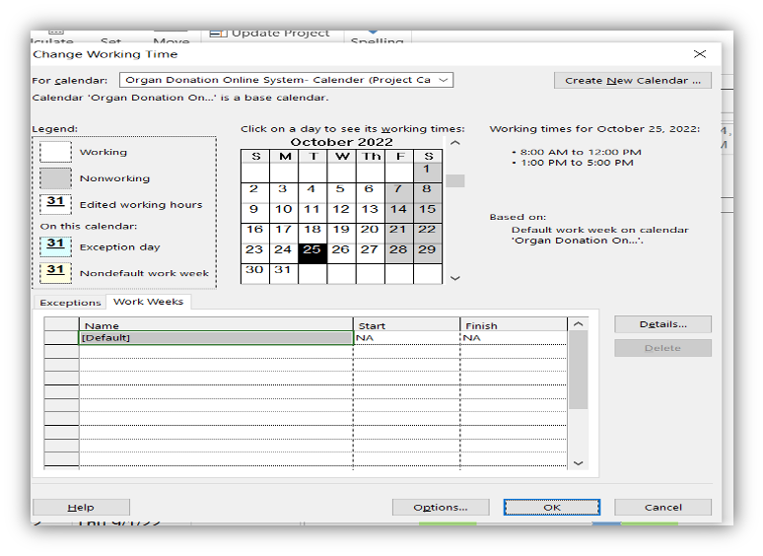
Project Calendar: Working days

Slide 15
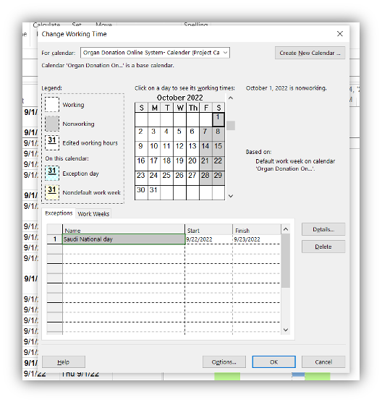
Project Calendar: Non working time

Slide 16
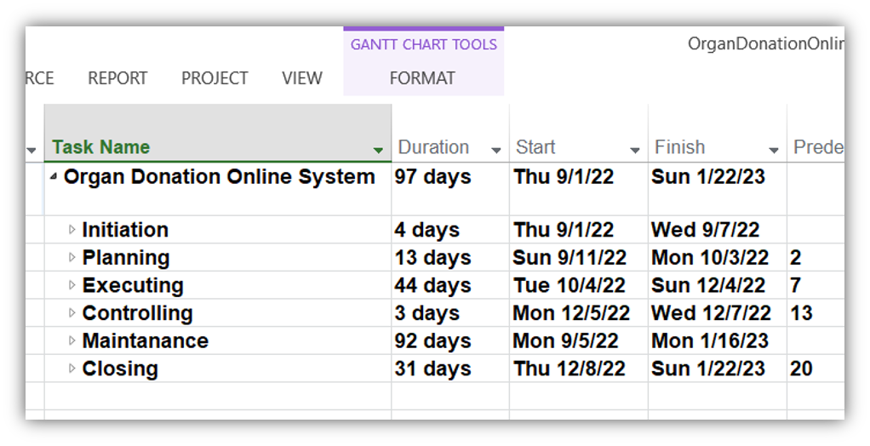
Names of summary Tasks (Phases)

Slide 17
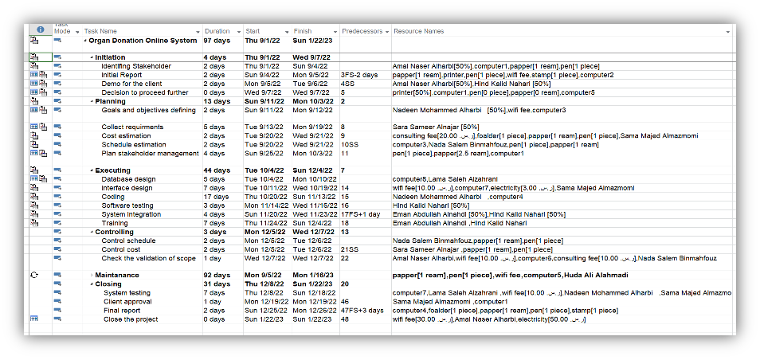
Names of subtasks & Tasks Duration Relationships & between tasks

Slide 18
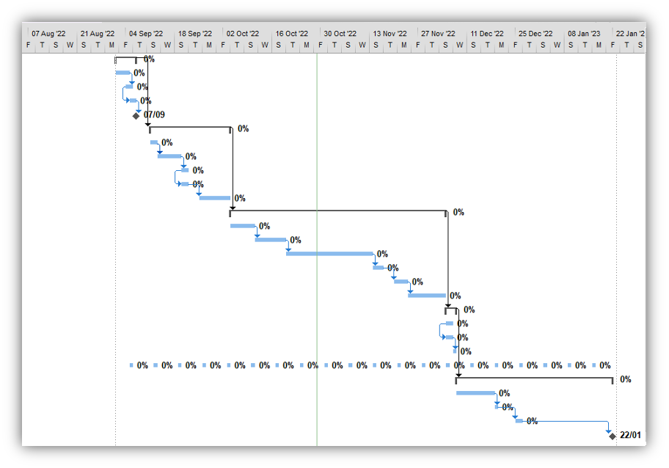
Relationships Between Subtasks

Slide 19
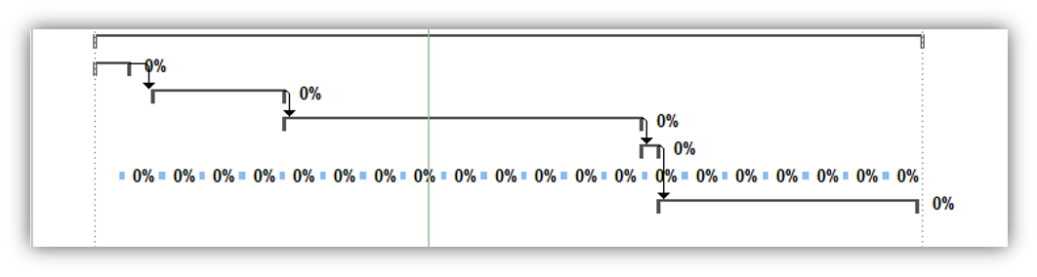
Relationships Between Summary Tasks

Slide 20
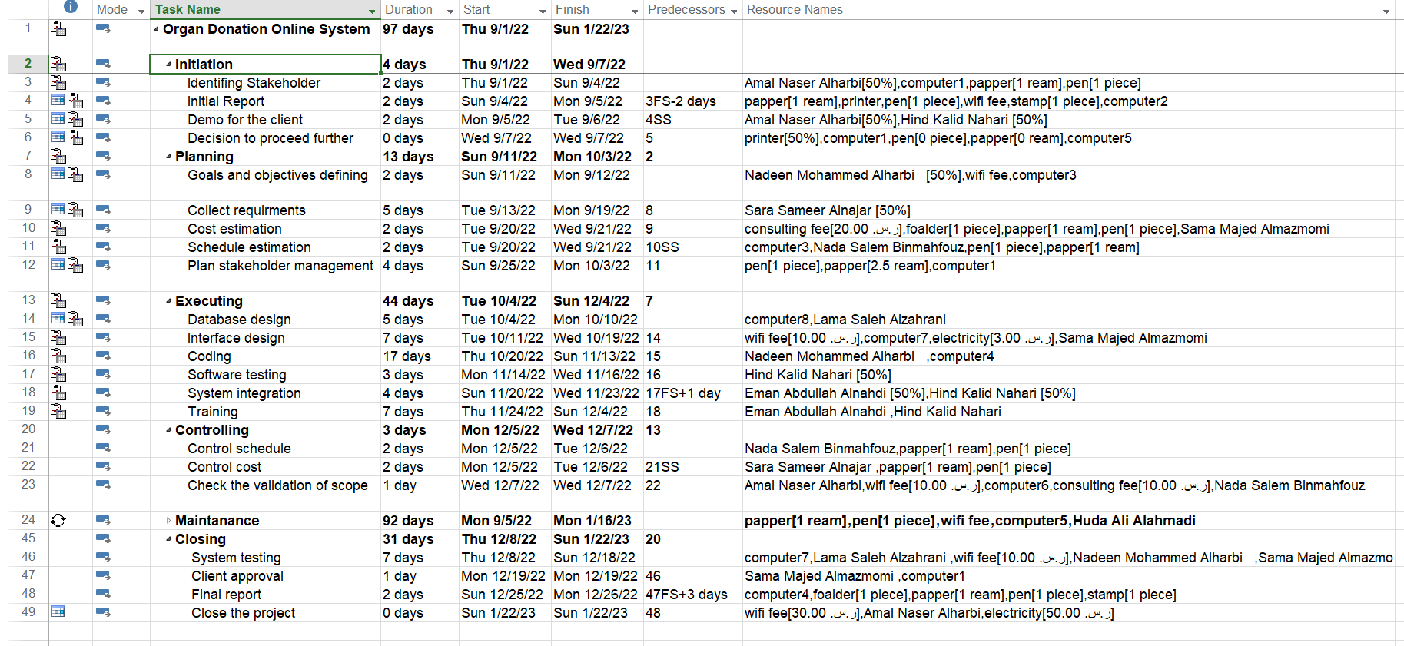

Milestones:

Slide 21
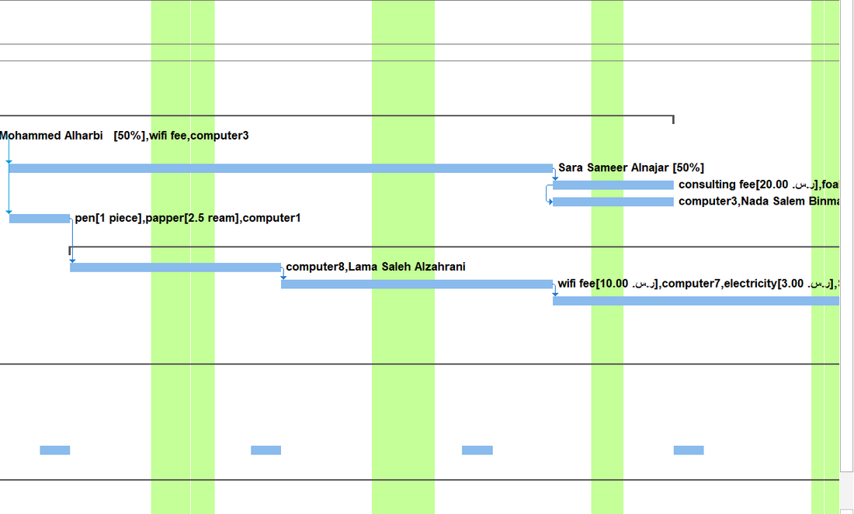
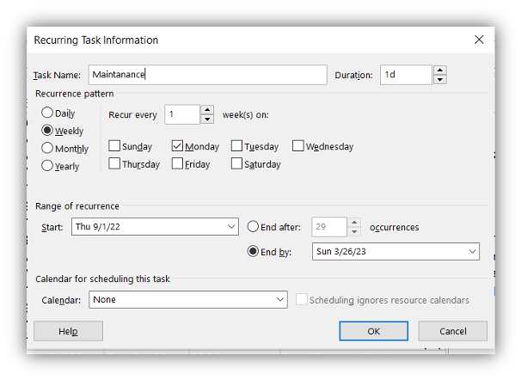
Recurring task every Monday:

Slide 22
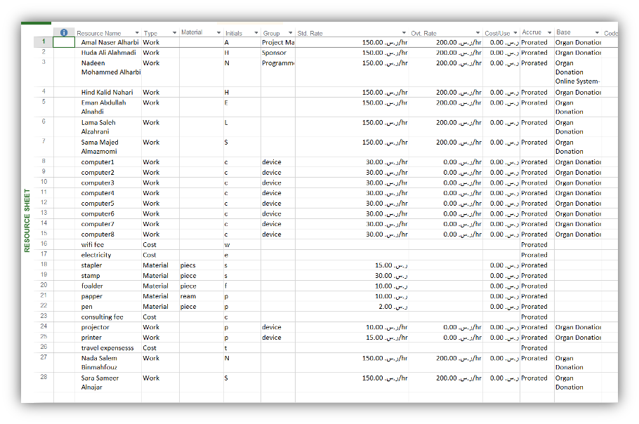
Types of resources (work- material- cost)

Slide 23
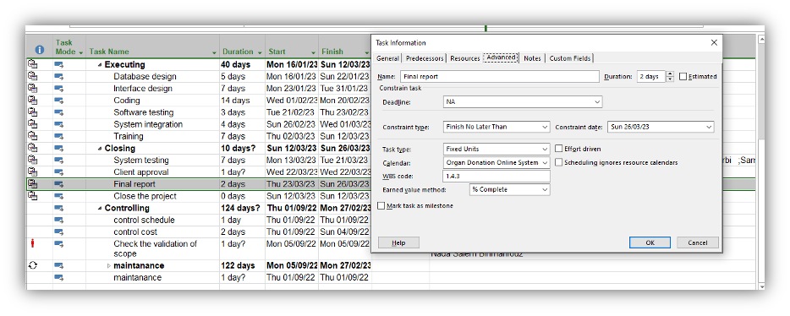
Task Have an or Semi-Flexible Constraint
Semi-flexible:
Task Final Report can finish before than or in 26-3-2023 Sunday.

Slide 24
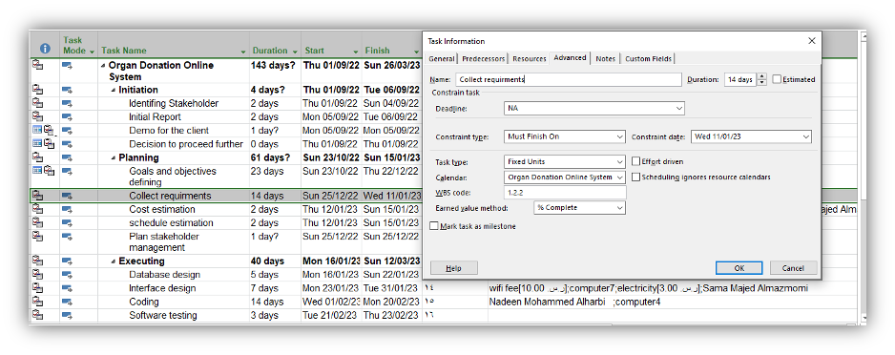
Task Have an Inflexible or Constraint
inflexible:
Task Collect requirements must finish at 11-1-2023 in Wednesday.

Slide 25
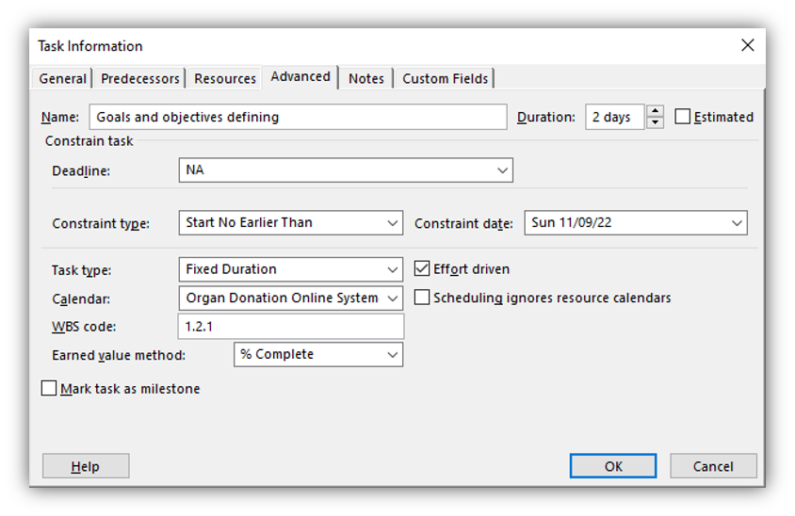
Task Have a Fixed Duration Type

Slide 26
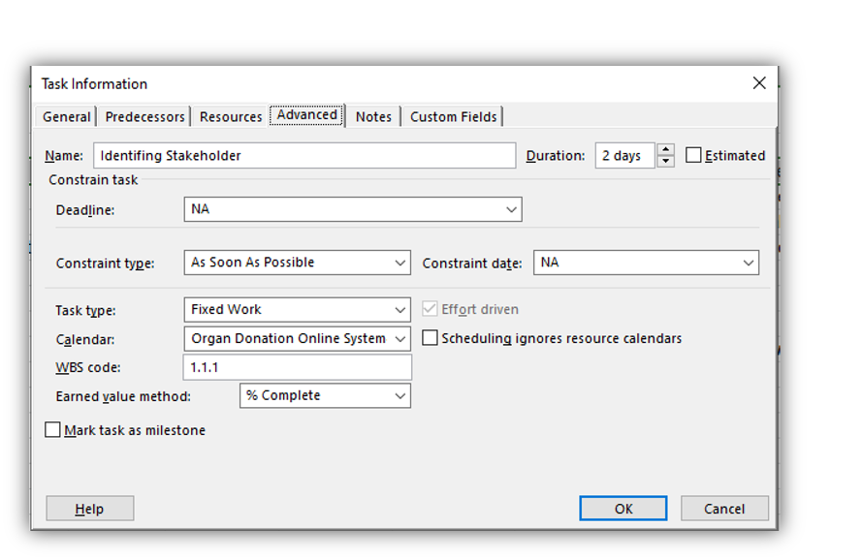
Task Have a Fixed Work Type

Slide 27
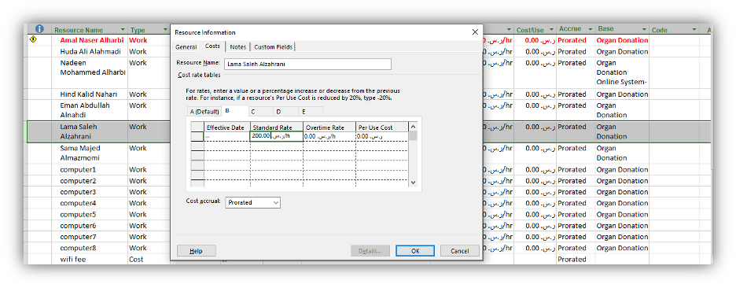
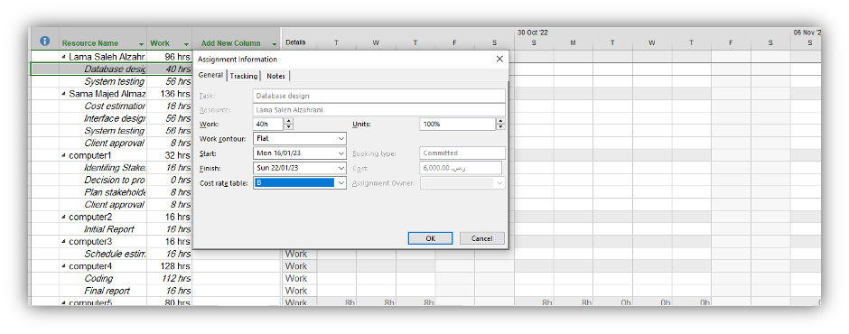
Person Resource Has a Multiple Pay Rate Depend on Task

Slide 28
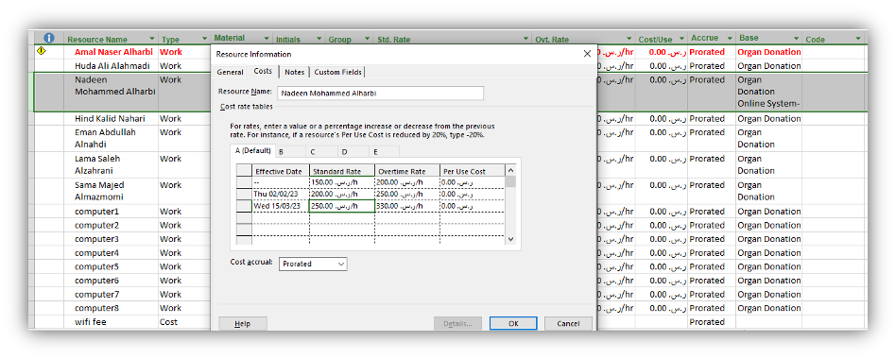
Person Resource Has a Multiple Pay Rate Depend on Time

Slide 29
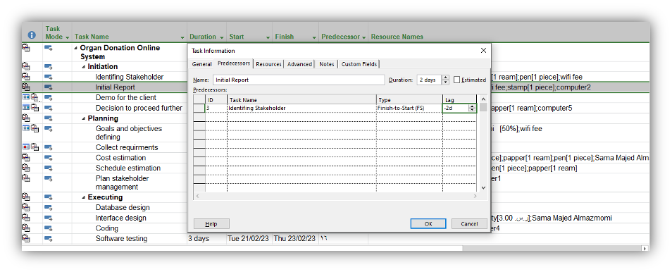
Tasks Have Lead Time:

Slide 30
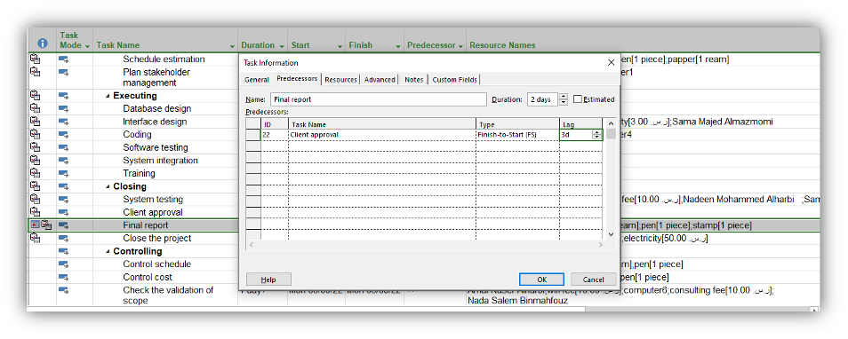
Tasks Have Lag Time:

Slide 31
References
Donate Life America: National donor description report card.[http://donatelife.net/2013-nationaldonor-description-report-card-released/]

Slide 32
Thank
you!

